Slide 1





EMBO Practical Course on
Computational analysis of protein-protein interactions: Sequences, networks and diseases
30th May - 4th June 2016 Budapest, Hungary
Protein interfaces and 3D modelling of protein complexes
Allegra Via
IBBE, National Research Council, Italy
Sapienza Università di Roma, Italy
Wednesday, 1st June 2016

Slide 2
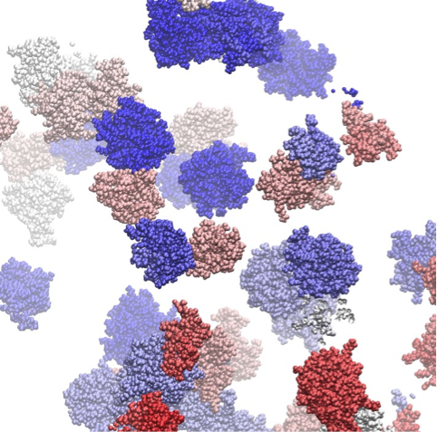
Protein interaction interfaces

Slide 3
Molecular dynamics simulation snapshot of a colicin E9 and Im9 protein solution (van der Waals presentation and individual colors for each protein) indicating multiple transient association events
Copyright: © Technische Universität München, Physik-Department T38
http://www.gauss-centre.eu/gauss-centre/EN/Projects/LifeSciences/2014/zacharias_crowded_enviroment.html?nn=1361034

Slide 4
Protein-ligand interactions
Protein functions are based on the capability of proteins to bind a certain ligand (or more)
elemental ions
small organic molecules (~600 Da or less)
peptides
macromolecules

Slide 5
A few definitions
Binary interaction
Protein complex
Hub
Homo vs hetero
Stable vs transient
Protein binding interface

Slide 6
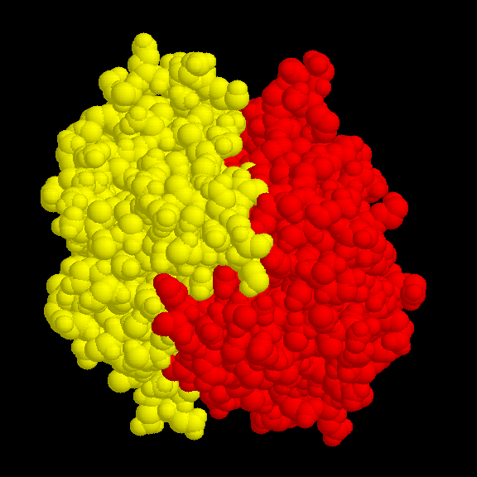
Binary interactions

Slide 7
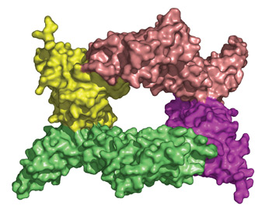
Protein complex
A structural image of the protein-protein complex formed when YpkA (green and pink) binds to the Rac1 protein of the host cell (yellow and purple)

Slide 8
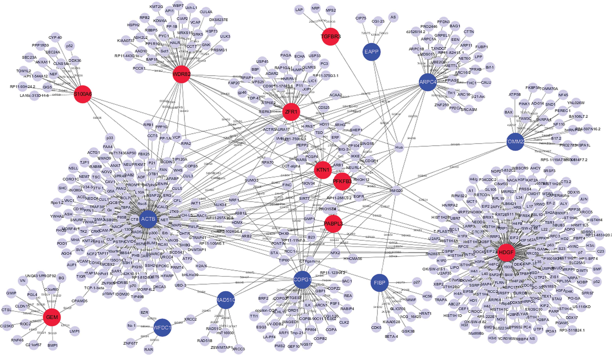
Protein interaction network - hubs

Slide 9
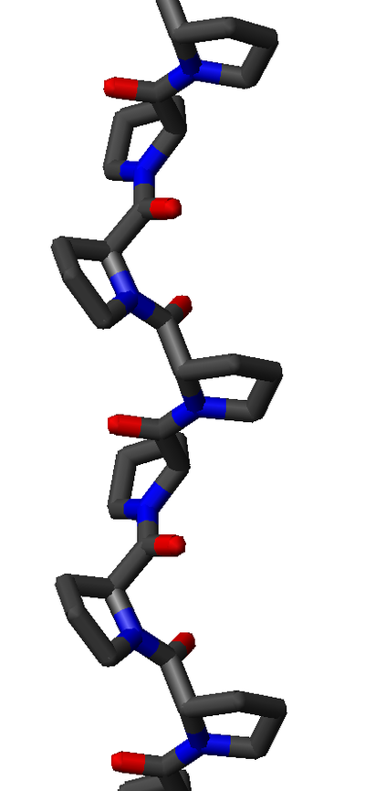
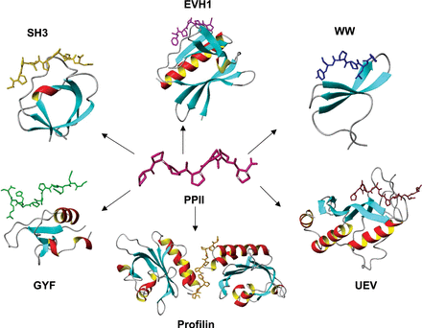
Polyproline type II helices

Slide 10
Strong transient: This category includes interactions that are triggered/stabilised by an effector molecule or conformational change. An example is given by the Ras proteins, which form tight complexes with their partners when GTP-bound and only weak complexes when GDP-bound.
Perkins et al, Structure, 2010

Slide 11
Protein-protein interactions
Transient interactions
Brief and reversible interactions occurring in specific cellular contexts
Stable interactions
Proteins take part of permanent complexes as subunits, in order to carry out structural or functional roles

Slide 12
Examples
Transient interactions
Interactions mediated by short linear motifs
Interactions mediated by PTMs
Disorder-to-order transitions
Proteins involved in signalling cascades
Stable interactions
Homo-oligomeric or hetero-oligomeric complexes
Interactions mediated by PTMs
enzyme-inhibitor
antibody-antigen
domain-domain
domain-peptide
Perkins et al, Structure, 2010

Slide 13
We can classify PPIs according to:
Biological context: enzyme-substrate, antibody-antigen, receptor-hormone/neurotransmitter
Permanence of binding: permanent-obligate vs transient
Similarity of the binding partners: homo vs hetero
Number of binding partners: hub, non-hub
Some of the above categories may partially overlap

Slide 14
Protein-ligand interfaces Structure-function relationship
The ability of proteins to form biologically active complexes depends on the properties of their binding surfaces:
Size
Geometric compatibility
Chemical composition
Polarity
Atom packing efficiency
Hydrogen bond or salt bridge frequency
Number of buried water molecules
Interaction energy
Residue conservation
Types of secondary structures

Slide 15
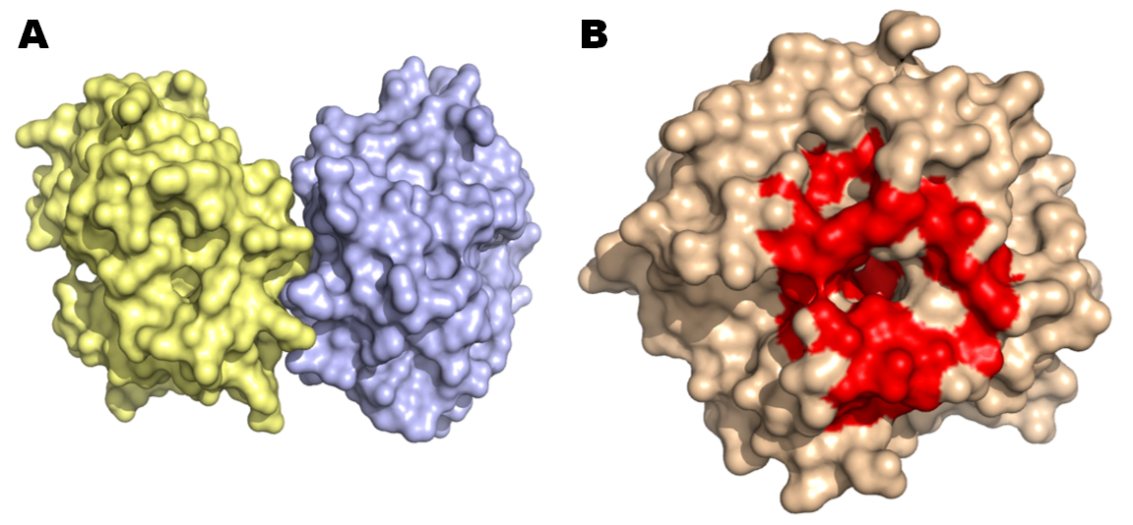
A. Hpx14 homodimer (PDB 3C7X) B. Definition of the docking site (red patch)

Slide 16
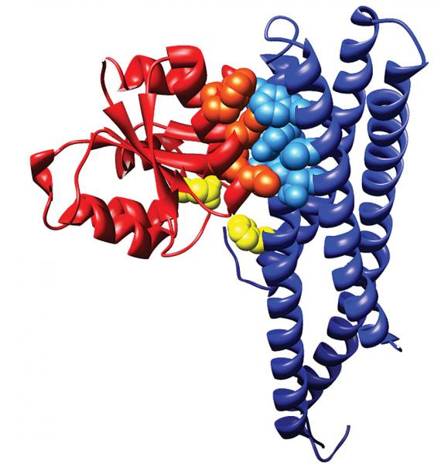
membrane-bound sensor histidine kinase
response regulator
. The catalytic residues that exchange a phosphoryl group are shown in yellow (courtesy of Alexander Schug and Hendrik Szurmant)

Slide 17
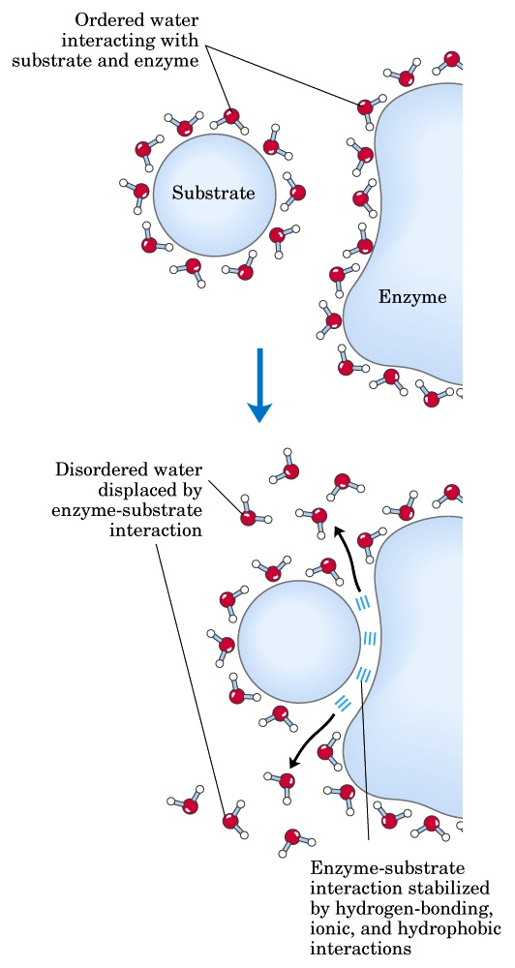
ΔG = ΔH - TΔS
Ligand binding is driven by the hydrophobic effect and van der Waals interactions, whereas electrostatic interactions make them specific
PPI interfaces tend to be more hydrophobic than surfaces that do not participate in the binding
Studies on enzymes demonstrate the importance of the hydrophobic effect also in binding non-protein substrates

Slide 18
Forces governing biomolecular recognition
Van der Waals
Electrostatics
Hydrophobic contacts
Hydrogen bonds
Salt bridges
All interactions act at short range → surface complementarity is needed for tight binding
Efrat Mashiach, http://bioinfo3d.cs.tau.ac.il/

Slide 19
The Binding Site (BS)
Geometry alone is insufficient to recognise the correct ligand
The binding site-ligand match is based on: geometry and electrostatics
Geometric and electrostatic complementarity can be achieved using different BS architectures

Slide 20
PPI surface size
The area of PPI interfaces is large (1000 to 4000 Å²)
Standard-sized interfaces are 1200 to 2000 Å²
Short-lived and low-stability complexes -> smaller interfaces (1150–1200 Å²)
Protein-small molecule interaction surfaces have a smaller area (300 - 1000 Å²).

Slide 21
Other PPI surface features
Flatter than that of other protein-ligand interfaces
Lack the grooves and pockets observed at the surfaces binding small molecules
Generally hydrophobic
Tighter atom packing
Lower polarity
Higher conservation (especially at the center of the interface)

Slide 22
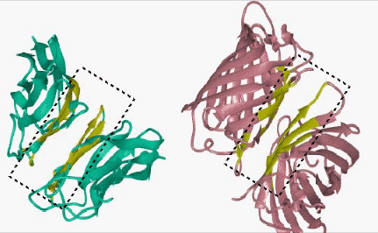
http://home.ku.edu.tr/~okeskin/INTERFACE/INTERFACES.html

Slide 23
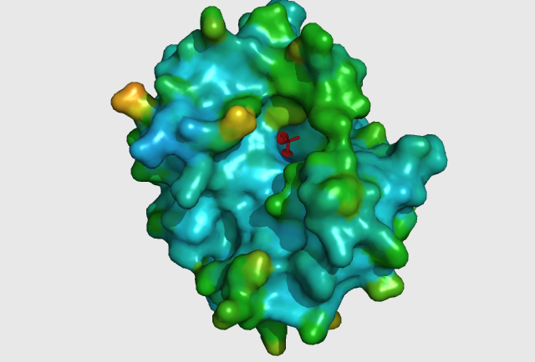
Protein-small molecule: small and deep depressions

Slide 24
Some more facts about PPIs
Transient interfaces differ from stable interfaces
Stable interfaces: less planar, more hydrophobic, better geometric and electrostatic complementarity
Homodimeric interfaces resemble protein cores
Heterodimeric interfaces are more like regular (i.e. non-binding) surfaces

Slide 25
Specificity
Conferred by electrostatic interactions
Electrostatic interactions prevent aggregation (mediated by non-polar interactions)

Slide 26
Protein-ligand binding energetics Protein-ligand affinities
Binding energies may range from -2.5 to -22 kcal/mol
Signal transduction networks -> weak interactions
Cofactor binding by enzymes (reversible but strong) -> -5.5 to -9.5 kcal/mol
Antibody-antigen: -8±3 kcal/mol
Receptor-hormone: -12 kcal/mol
Enzyme-inhibitor: -12±3 kcal/mol
Enzyme-transition state: -22±5 kcal/mol
Kuntz et al., 1999; Zhang&Houk, 2005

Slide 27
Hot spots
The protein-protein binding interface is heterogeneous
Only certain hydrophobic spots contribute to the free energy of binding and help to hold the two proteins together
Affinity seems to result from a small number of residues
Such residues are called hot spots
Hot spots are defined as residues whose replacement by alanine leads to an affinity/free energy change of at least 2 kcal/mol

Slide 28
Some fact about hot spots
Hot spots account for less than 50% of the contact area of PPI
Hot spots tend to be evolutionary conserved
Hot spots tend to appear as clusters in the interface
Some residues are found more frequently in hot spots (e.g., Phe, Tyr, Trp)
Hot spots are surrounded by energetically less important residues that probably separate/prevent bulk water from hot spots

Slide 29
How PPI surfaces can be studied?
Experimental:
The most significant contribution to understanding the PPI surface comes from structural biology via X-ray crystallography or NMR as well as mutational studies
Computational:
Prediction of interaction/binding sites
Prediction of protein-protein complexes
In silico mutational studies

Slide 30
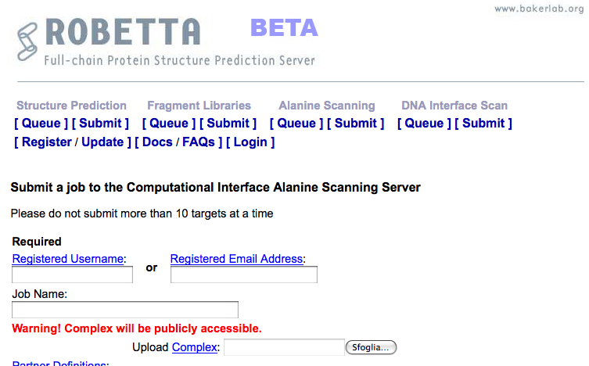
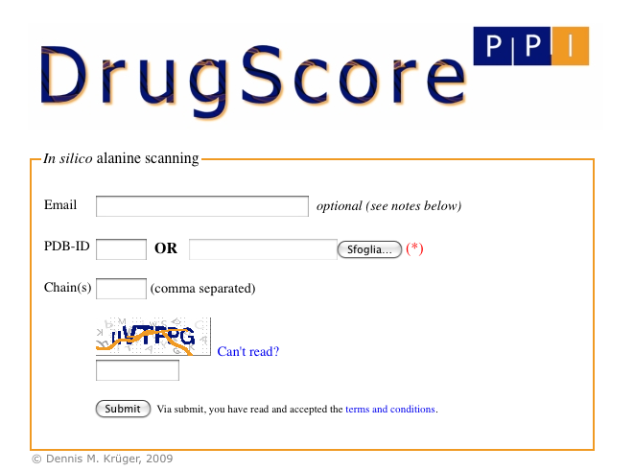
Computational alanine-scanning in protein-protein interfaces
http://robetta.bakerlab.org/alascansubmit.jsp
http://cpclab.uni-duesseldorf.de/dsppi/
DrugScorePPI and Robetta Alascanning are dedicated to the identification of hot spots at protein-protein interfaces

Slide 31
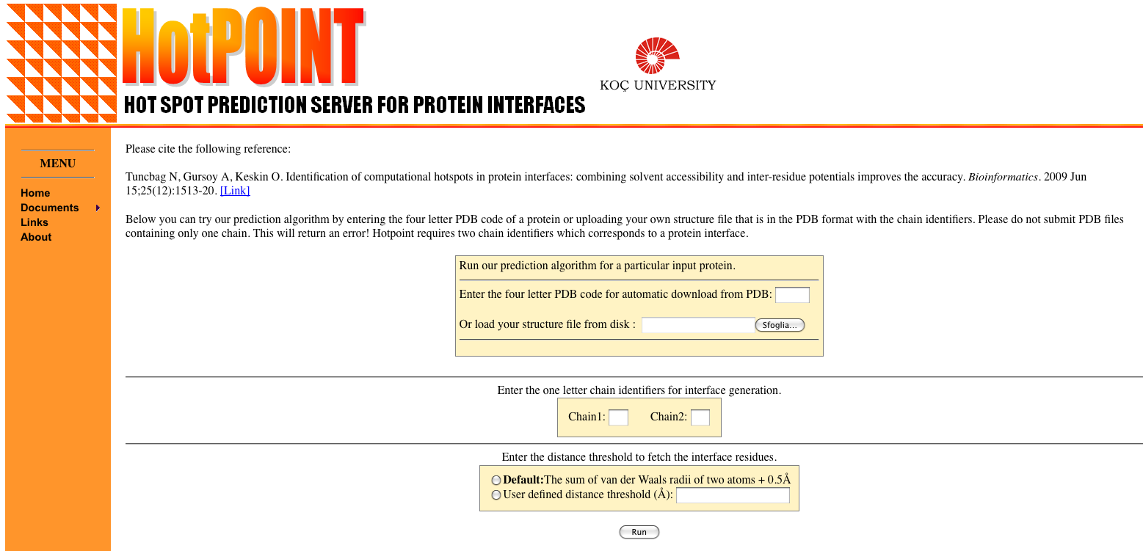
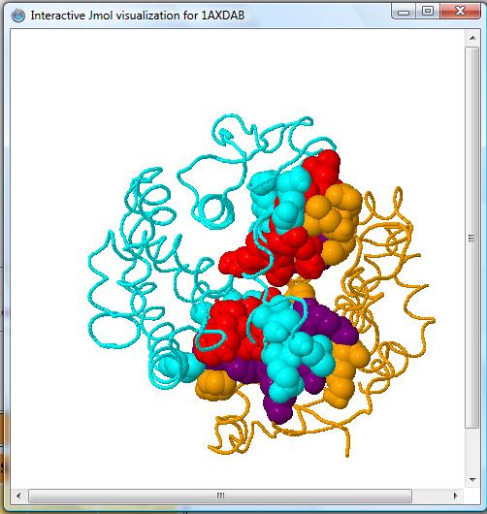
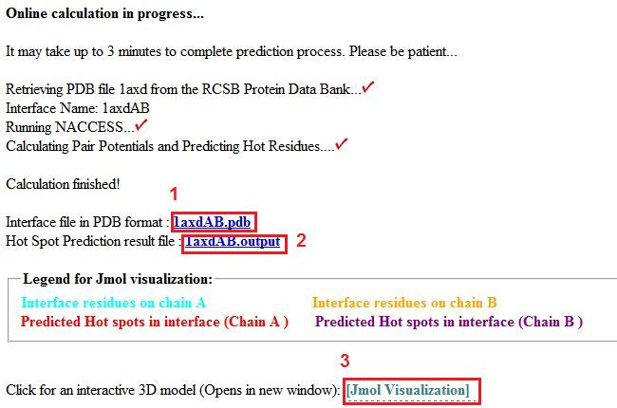
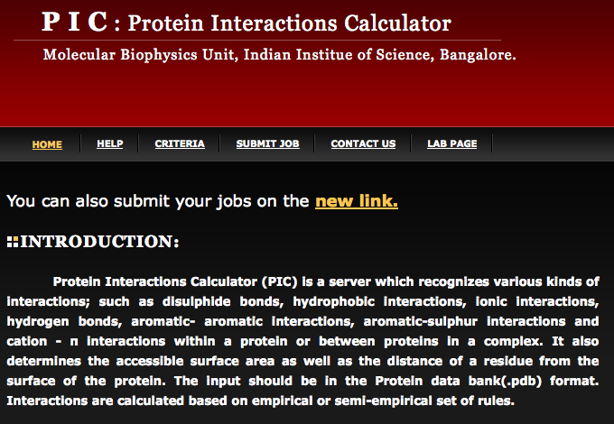
http://prism.ccbb.ku.edu.tr/hotpoint/
HotPOINT calculates solvent accessibilities and total contact potentials. It predicts hot spots at the complex interface
http://crick.mbu.iisc.ernet.in/~PIC/
PIC recognises various kinds of interactions, such as disulphide bonds, hydrophobic interactions, ionic interactions, hydrogen bonds, aromatic- aromatic interactions, aromatic-sulphur interactions and cation-π interactions between proteins in a complex

Slide 32
Prediction of protein-protein interactions
Phylogenetic profiling
Prediction of co-evolved protein pairs based on similar phylogenetic trees
Rosetta stone method
Association methods
Bayesian network modelling
Domain-pair exclusion analysis
Supervised learning problem
Gene fusion
Classification methods
Inference of interactions from homologous structures
Identification of structural patterns (hot spots)
Protein-protein docking
3D

Slide 33
3D modelling of protein complexes

Slide 34
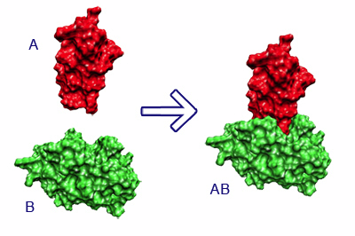
What is molecular docking?
Computational schemes that attempt to find the “best” matching between two molecules, a receptor and a ligand
The molecular docking problem can be defined as follows: given the atomic coordinates of two molecules, predict their “correct” bound association
Halperin et al. Proteins, 2002

Slide 35
Protein-protein docking: modelling the structure of protein complexes
Used to model protein complexes
It is the “gold standard” for prediction of PPIs
It makes it possible to figure out how the interaction takes place ("mode" of binding)
It is computationally very challenging and thus very unlikely to be applied for high throughput purposes
Ngounou Wetie et al. Proteomics, 2013

Slide 36
What types of questions can docking address?
If receptor and ligand do bind in vivo:
What is the spatial configuration they adopt in their bound state?
What is the structure of the protein complex (near-native structure) in atomic details ?
How strong or weak is their interaction (= which types of interactions are present)?
What is the orientation that maximises the interaction, minimising the energy of the complex?
If they don't bind:
Would they bind if there was a mutation?

Slide 37
Docking prerequisites
The molecular structure (spatial coordinates) of the interacting partners
has been determined experimentally
or
can be "safely" predicted
Computing power

Slide 38
"Bound" docking
Tries to reconstruct a complex using the bound structures of the receptor and the ligand
After artificial separation of the receptor and the ligand, the goal is to reconstruct the native complex
No conformational changes are involved
Used as first test to validate the algorithm

Slide 39
"Unbound" or "predictive" docking
Tries to reconstruct a complex using the unbound structures of the receptor and the ligand
An "unbound" structure maybe a native structure, a pseudo-native structure, or a modelled structure
Native: free in solution, in its uncomplexed state
Pseudo-native: structure complexed with a molecule different from the one used for the docking
Halperin et al. Proteins, 2002

Slide 40
Unbound docking
It is far more complex than bound docking
Problems:
conformational changes (side-chains and backbone movements)
experimental errors in the structures
reliability of models

Slide 41
The three key ingredients in docking
Representation of the system
Conformational space search
Ranking of potential solutions

Slide 42
The three key ingredients in docking
Representation of the system

Slide 43
Representation of the system
Docking essentially simulates the interaction of the protein surface
How do we define a protein surface?
Mathematical models (e.g. geometrical shape descriptors, a grid)
Static or dynamic treatment of the protein frame (rigid vs flexible)

Slide 44
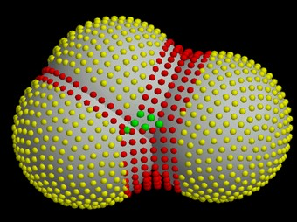
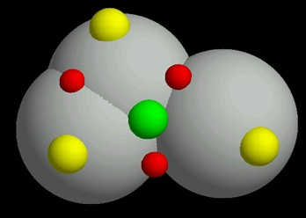
Surface representation
Dense surface (Connolly)
Sparse surface (Shuo Lin et al.)
The choice of the system (surface) representation decides the types of conformational search algorithms, and the ways to rank potential solutions
http://www.chem.leeds.ac.uk/ICAMS/eccc/cangaroo.html

Slide 45
The three key ingredients in docking
Representation of the system
Conformational space search

Slide 46
Conformational space search
Efficient search algorithm – fast and effective in covering the relevant conformational space
Computationally difficult - there are many ways to put two molecules together (3 translational + 3 rotational degrees of freedom)
Goal: locate the most stable state (global minimum) in the energy landscape

Slide 47
Rigid vs flexible docking
Rigid body - highly simplistic model regarding the two proteins as two rigid solid bodies
Semi-flexible - one of the molecules is considered flexible, while the receptor is regarded as rigid
Flexible docking – both molecules are considered flexible, though flexibility is limited or simplified

Slide 48
Docking algorithms
Rigid docking
fast → can explore the entire receptor and ligand surfaces
Less accurate
flexibility = "soft" belt into which atoms can penetrate
Flexible docking
Slower
More accurate
Can model side-chain/backbone flexibility
highly reliable but too slow for extensive ligand docking

Slide 49
Docking approaches
scan of the entire solution space in a predefined systematic manner
e.g., complete searches of all orientations between two rigid molecules by systematically rotating and translating one molecule about the other
2) gradual guided progression through solution space Only part of the solution space is searched, or fitting solutions* are generated.
e.g., Monte Carlo, simulated annealing, molecular dynamics (MD), and evolutionary algorithms.
3) data-driven docking – it uses the available information about binding site/interface residues
* Solutions meeting pre-defined criteria

Slide 50
Docking approaches
Although each method is optimal for a specific class of protein docking problems, combining computational steps from different methods can improve the reliability and accuracy of results.
Global methods work well when none of the interacting partners undergo conformational changes larger than 2 Å. In particular, when no prior information on the complex is available, requirig the search of the entire conformational space.
Monte Carlo methods yield good results when side-chain repacking is crucial, e.g., when one of the protein structures is a homology model.
Data-driven methods produce the best results if sufficient information on interface residues is available, even when the binding causes large conformational change, including the backbone.

Slide 51
The three key ingredients in docking
Representation of the system
Conformational space search
Ranking of potential solutions

Slide 52
Ranking of potential solutions
A search algorithm may produce an immense number of solutions (10⁹)
A good scoring function is fast enough to allow its application to a large number of potential solutions
Goal: discriminate between "correct" native solutions, i.e. with low rmsd from the crystal structure, and others within reasonable computation time

Slide 53
To solve the docking problem, ideally, the best matching algorithms and scoring schemes should be combined
Two-stage ranking:
fast scoring to rapidly scan possible solutions and obtain initial "good" candidates – mostly geometric criteria
Followed by more advanced methods to further discriminate the limited conformations - energy criteria
Binding site information (known or predicted) may be included in scoring

Slide 54
Kozakov et al, Biophys J, 2005
Clustering of solutions
Events that occur in clusters are probably not random
The cluster with the largest number of low-energy structures is typically the native fold, the center of the most populated cluster being a structure near the native binding site
Looking for large clusters is a major tool of finding near-native conformations

Slide 55
Conclusion I (-)
The molecular docking problem is far from being solved
It is difficult to find very specific properties of protein-protein interfaces
Results are generally poor with weakly interacting proteins
Proteins are flexible and may undergo even large conformational changes upon binding
Exhaustive space searches provide too many conformations
Accurate interaction energies are too complicated to compute

Slide 56
Conclusion II (-)
Despite some algorithms are able to rank correct solutions within the top ten predictions, for most complexes the highest ranked structures are still false positives (high rmsd from the complex)
No efficient method for reliable discrimination between correct solutions and FPs is currently available, in particular if the binding site is unknown
Many FPs displaying good surface complementarity are far from the native complex

Slide 57
Conclusion I (+)
If the conformational change is limited to surface side-chain atoms, rigid body algorithms have been remarkably successful, even in absence of knowledge of the binding site
Side-chain flexibility can be handled via a "soft" tolerance belt

Slide 58
Conclusion II (+)
Integration of experimental information produces reliable docking results
Relatively easy for enzyme-inhibitor complexes
Sometimes good results with antigen-antibody pairs

Slide 61
ClusPro http://nrc.bu.edu/cluster
The first fully automated, web-based program for the computational docking of protein structures
The docking algorithms evaluate billions of putative complexes, retaining a preset number with favorable surface complementarities
A filtering method is then applied to this set of structures, selecting those with good electrostatic and desolvation free energies for further clustering
The program output is a short list of putative complexes ranked according to their clustering properties

Slide 62
ClusPro http://nrc.bu.edu/cluster
User Input: PDB files of the 2 protein structures
Output: 10 (default) top predictions of docked conformations close to the native structure
Rigid body docking is performed using 2 established FFT-based docking programs (DOT and ZDOCK)
The scoring is solely based on the surface complementarity between the two structures
Over 2.7 10¹⁰ structures are evaluated, retaining 20 000 structures with the best surface complementarity scores, which are then further subjected to an empirical free energy filtering algorithm

Slide 63
ClusPro http://nrc.bu.edu/cluster
The free energy of the complex structure is typically dominated by van der Waals interactions, which is a very noisy function and difficult to calculate, especially with incorrect side-chain rotamers
Therefore, other components of the binding free energy are used to account for the noise of the van der Waals energies
Desolvation free energy using the atomic contact potential (statistical measure of the desolvation free energy)
Electrostatic free energy using a Coulombic model with a distance-dependent dielectric of 4r

Slide 64
ClusPro http://nrc.bu.edu/cluster
The top 2000 energetically favorable structures are clustered on the basis of a pairwise binding site root mean squared deviation (RMSD) criterion
Clusters are then formed by selecting the ligand that has the most neighbors below a previously selected clustering radius.
The ligand with the most neighbors is the cluster center, and is the representative structure for the cluster

Slide 65
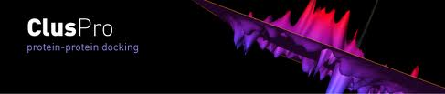
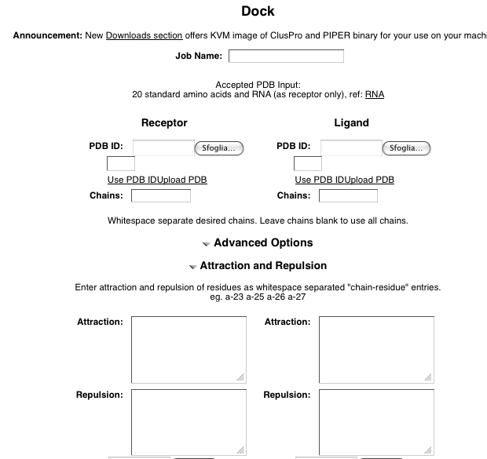

Slide 67
The HADDOCK protocol
Rigid-body docking followed by
a semi-flexible refinement of the interface in torsion angles' space (of both backbone and side-chains)
as a final stage, a Cartesian dynamics refinement in explicit solvent

Slide 68
The HADDOCK services
the Easy interface
the Prediction interface
the Expert interface (requires Expert level access)
the Refinement interface (requires Expert level access)
the Guru interface (requires Guru level access)
the Multi-body interface (requires Guru level access)
the File upload interface

Slide 69
The EASY interface

Slide 70
The EXPERT interface

Slide 71
The GURU interface

Slide 72
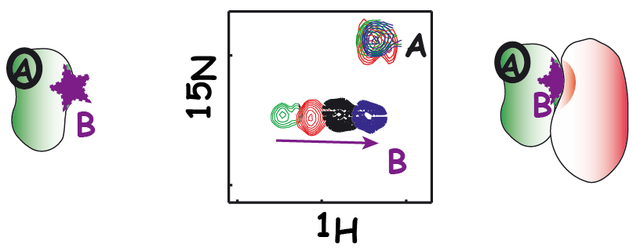
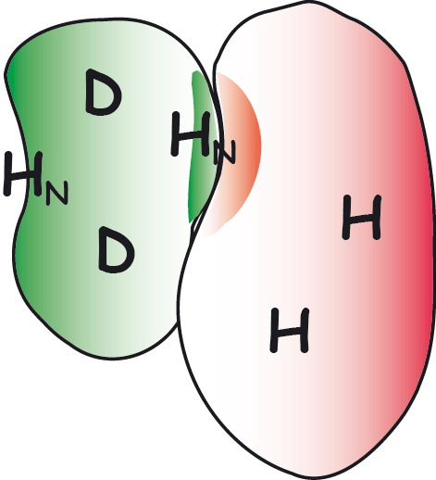
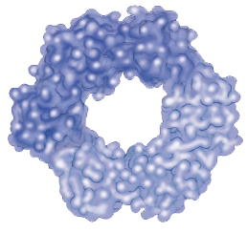
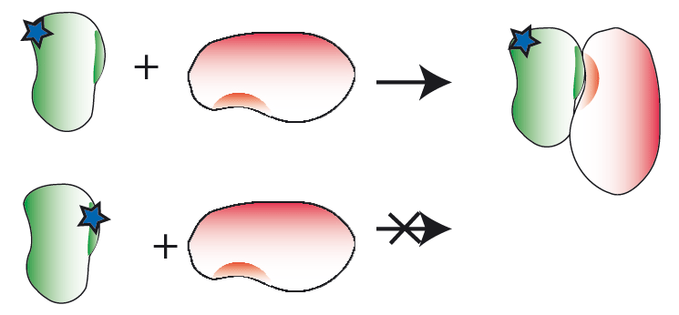
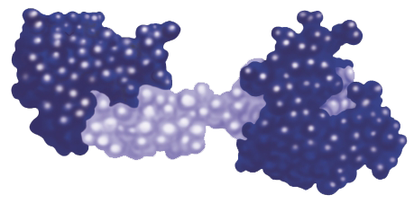
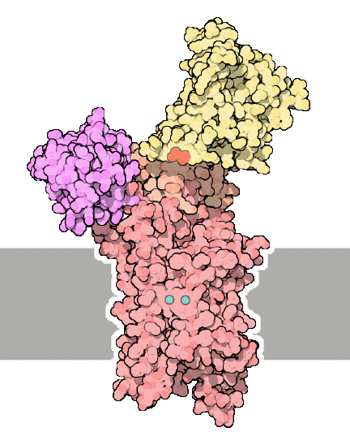
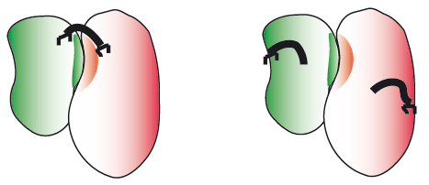
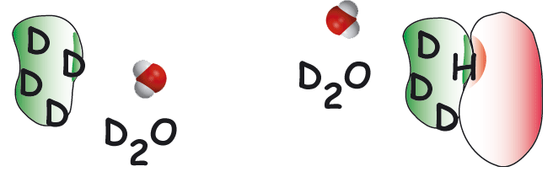
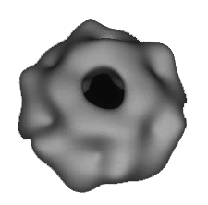
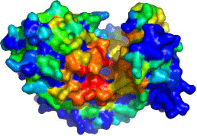
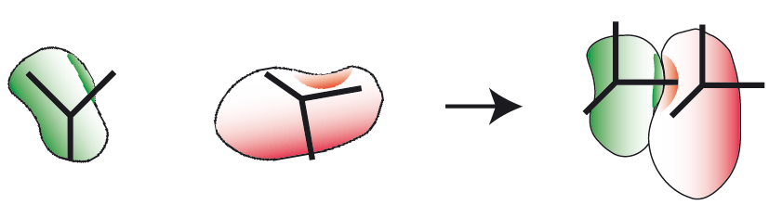
NMR titrations
NMR crosssaturation
mutagenesis
Cross-linking
HADDOCK
High Ambiguity Driven DOCKing
x
B
y
j
z
H/D exchange
A
i
k
d_{iAB}^{eff}
Other sources
e.g. SAXS, cryoEM
Bioinformatic predictions
EFRGSFSHL
EFKGAFQHV
EFKVSWNHM
LFRLTWHHV
IYANKWAHV
EFEPSYPHI
NMR anisotropy data
RDCs, para-restraints, diffusion anisotropy
http://haddocking.org; http://www.nmr.chem.uu.nl/haddock

Slide 73
Parameters supported by the various HADDOCK web interfaces
de Vries et al., Nature Protocols, 2010

Slide 74
Example of HADDOCK output
In this case additional experimental information has to be taken into account to completely rule out alternatives to the highest-scoring solution
In this case additional experimental information has to be taken into account to completely rule out alternatives to the highest-scoring solution
de Vries et al., Nature Protocols, 2010
Notes:
The top structure of the top cluster hase an interface RMSD of only 1.1 A to the first model of NMR structure. The second cluster in which oner component is 90° rotated has an HADDOCK score very similar, therefore in this case additional experimental information has to be taken into account to completely rule out alternatives to the highest-scoring solution.

Slide 75
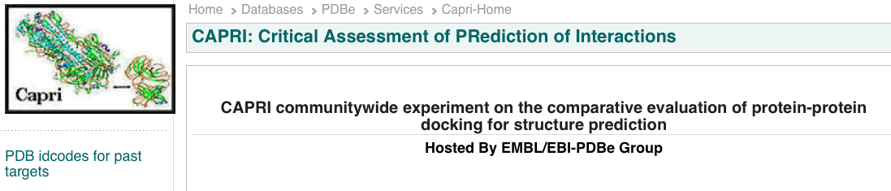
CAPRI: Critical Assessment of PRotein Interactions
http://www.ebi.ac.uk/msd-srv/capri/
CAPRI is a community-wide experiment in modelling the molecular structure of protein complexes
CAPRI is a blind prediction experiment aimed at testing the performance of protein docking methods
Rounds take place about every six months
Each round contains between one and six target protein–protein complexes whose structures have been recently determined experimentally
Targets are unpublished crystal or NMR structures of complexes, whose coordinates are held privately by the assessors, with the co-operation of the structural biologists who determined them
The atomic coordinates of the two proteins are given to groups for prediction

Slide 76

CAPRI: Critical Assessment of PRotein Interactions
The CAPRI experiment is double-blind
submitters do not know the solved structure
the assessors do not know the correspondence between a submission and the identity of its creator
International meetings
Proteins: Structure, Function, and Bioinformatics
Special CAPRI Issue: Fifth Meeting on the Critical
Assessment of Predicted Interactions
December 2013

Slide 77
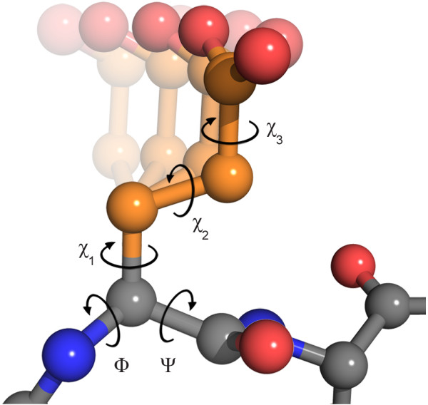
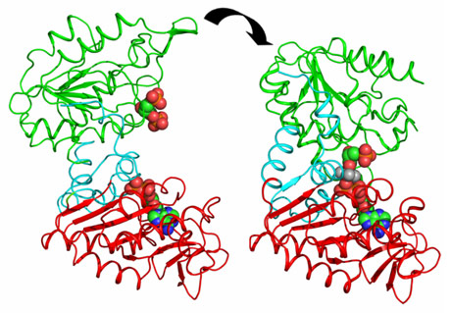
CAPRI drives the community to develop new techniques
Side-chain flexibility
First rounds the big challenge was to model correctly side-chain conformations
Dihedral angles in glutamate
Domain movements
Today the development is focused on backbone flexibilty
Domain movements in PGK catalysis.
J. Biol. Chem. (2011) 286, 14040-14048
The clustering application to protein-protein docking was first introduced in CAPRI by Camacho & Gatchell,D. (2003)

Slide 78

CAPRI experiment … who is the winner ??
There is no official ranking and in many cases the differences between the different algorithms are not huge

Slide 79
CAPRI experiment … who is the winner ??
HADDOCK (software/web server). http://haddock.chem.uu.nl
CLUSPRO (software/web server)
http://cluspro.bu.edu
ICM-pro (desktop-modeling environment)
http://www.molsoft.com/protein_protein_docking.html
ROSETTADOCK (software/web server) http://graylab.jhu.edu/docking/rosetta/
http://rosettadock.graylab.jhu.edu/submit
GRAMM-X (web server) http://vakser.bioinformatics.ku.edu/resources/gramm/grammx
PATCHDOCK/FIREDOCK (software/web server) http://bioinfo3d.cs.tau.ac.il/PatchDock/
HEX (software/web server) http://hexserver.loria.fr

Slide 80
Course materials
https://github.com/aidanbudd/ppisnd/tree/gh-pages/trainingMaterial/allegraVia
Suggested readings:
La et al. Predicting permanent and transient protein-protein interfaces. Proteins 2013
Perkin et al. "Transient Protein-Protein Interactions: Structural, Functional, and Network Properties" Structure 2010
Bendell et al. Transient protein-protein interface prediction: datasets, features, algorithms, and the RAD-T predictor. BMC Bioinformatics 2013

Slide 81
Parameters used for scoring
Geometric complementarity - how to score complementarity is strongly coupled with the surface representation
Intermolecular overlap – tolerance to slight interface clashes and penalty for protein interior clashes (surface "belt" of nonpenalised penetration area)
Intra-molecular overlap – when backbone flexibility is taken into account
Hydrogen bonding
Contact area: total interactions = hh + pp + hp (h = hydrophobic, p = polar)
Pairwise aa and atom-atom contacts – empirical term derived form observed statistical frequency of aa contacts in X-ray proteins
Electrostatic interactions and solvation energy

